Slide 1
Digital libraries, repositories, and search engines
Presented By,
Mohammed Nauman Siddique

Slide 2
What is a Digital Library?
A digital library is a managed collection of information, with associated services, where the information is stored in digital formats and accessible over a network.
Stream of data sent to earth from a satellite (Not a digital library)
Organized systematically, becomes a digital library collection.
Taken From: http://home.wlu.edu/~whaleyt/classes/DigiLib/Whaley/Definition.html
Notes:
Associated Services: searching, and retrieving

Slide 3
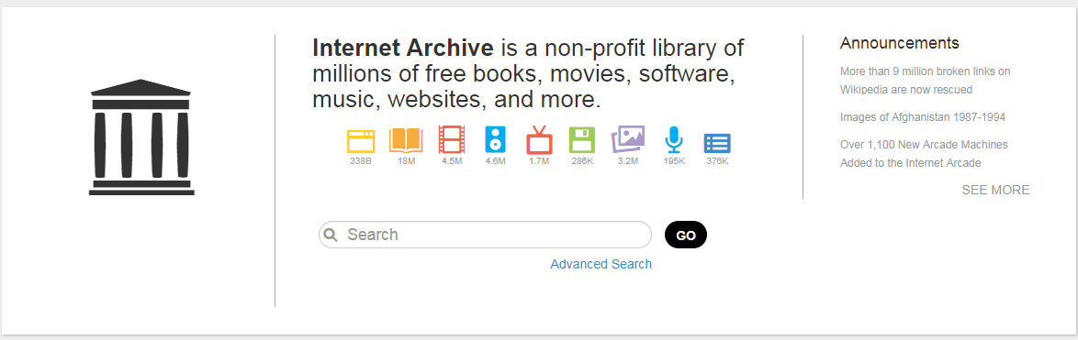
Why Digital Libraries?
Taken from: https://archive.org/

Slide 4
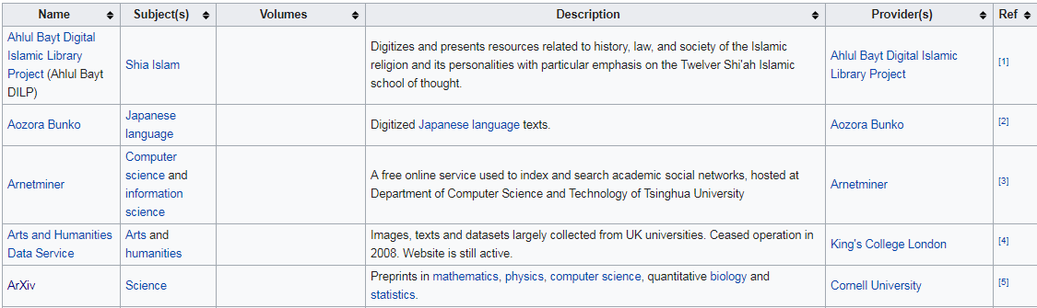
List of Digital Library Projects on Wikipedia
Taken From: https://en.wikipedia.org/wiki/List_of_digital_library_projects

Slide 5
Types of Digital Libraries
Institutional Repositories
An institutional repository is an archive for collecting, preserving, and disseminating digital copies of the intellectual output of an institution, particularly a research institution.
DSpace and Fedora are two widely used frameworks to build institutional repositories
Digital Archives
A digital archive is a repository that stores one or more collections of digital information objects with the intention of providing long-term access to the information.

Slide 6
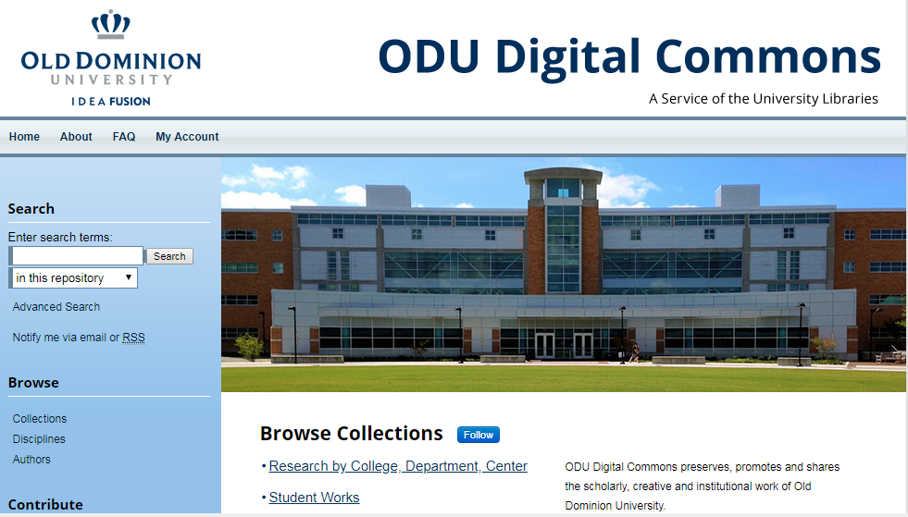
ODU Digital Commons (Institutional Repository)
Taken from: https://digitalcommons.odu.edu/

Slide 7
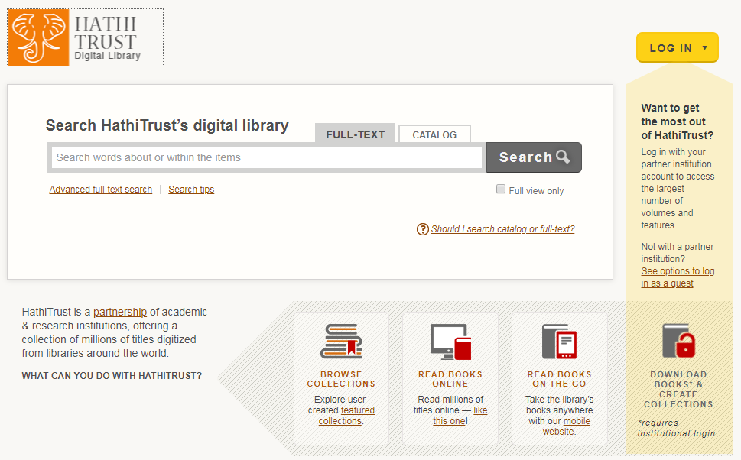
HathiTrust (Digital Archive)
Taken from: https://www.hathitrust.org/

Slide 8
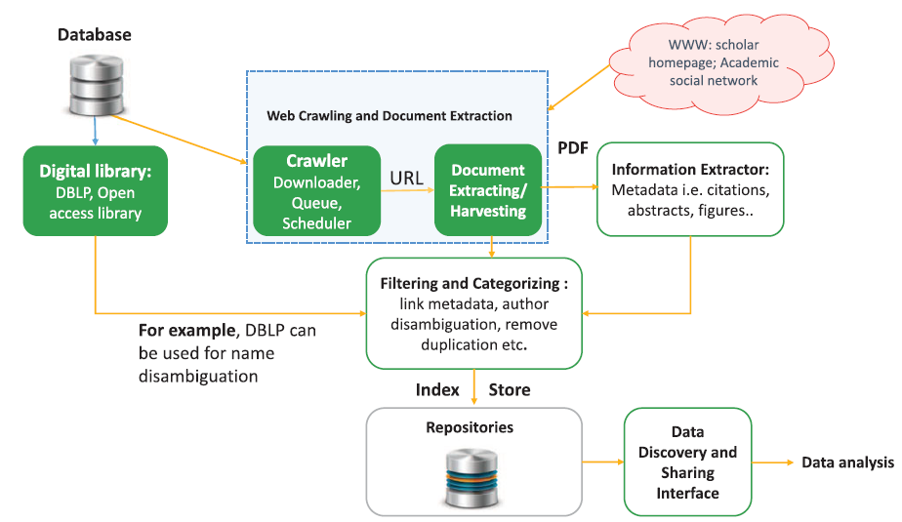
Scholarly Data Collection
Courtesy: Xia et.al, “Big Scholarly Data: A Survey”, IEEE Transactions on Big Data, 2017

Slide 9
Web Crawling and Document Extraction
Crawl the Web
Extract links to PDF files
Form a queue of extracted URLs
Schedule crawl time
Update queue to include any new documents

Slide 10
Data Discovery
Scholarly Documents -> DOIs (Digital Object Identifiers)
A Digital Object Identifier or DOI is a persistent identifier or handle used to uniquely identify objects, standardized by the International Organization for Standardization (ISO).

Slide 11
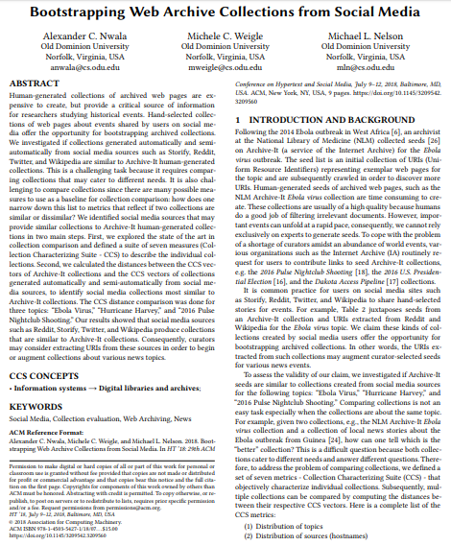
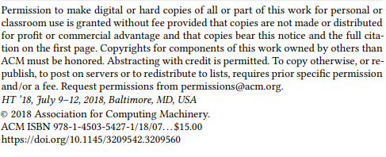
Digital Object Identifiers (DOI)
Taken from: https://www.cs.odu.edu/~mln/pubs/ht-2018/hypertext-2018-nwala-bootstrapping.pdf

Slide 12
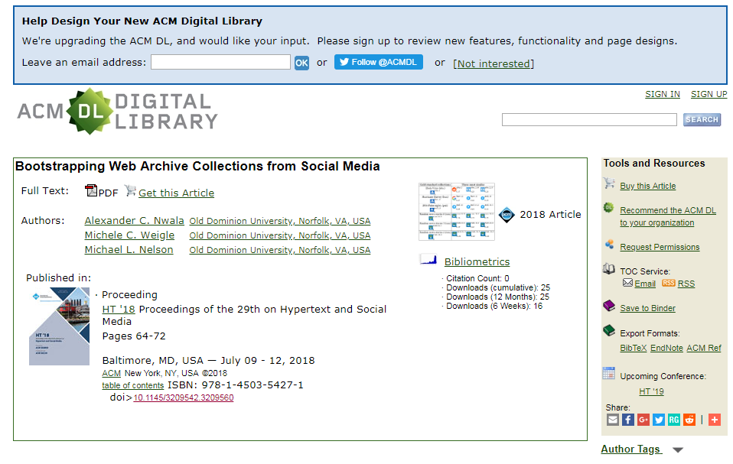
DOI Search Result
Taken from: https://dl.acm.org/citation.cfm?doid=3209542.3209560

Slide 13
Scholarly Information Extraction
Metadata Extraction
Title, authors, year and venue
Citation Extraction
References, Bibliography or Sources
Author Detail Extraction and Profiling
Author’s name, affiliations, titles and research grants
Other Information Extraction
Figures, algorithms, acknowledgements etc.

Slide 14
Big Data Storage Mechanism
Data is available in structured, semi-structured or unstructured forms.
Google Big Table, MapReduce, Hadoop and Data Stream Management System(DSMS) used for data storage and management.

Slide 15
Citation Index: For Connecting Scholarly Documents
A citation index catalogues the citations that an articles makes, linking the articles with the cited work.

Slide 16
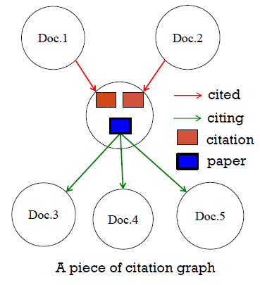
Citation Graph: Finds relationship between articles
Courtesy: Jian Wu Lecture Slides from CS 795.895 on Scholarly Big Data

Slide 17
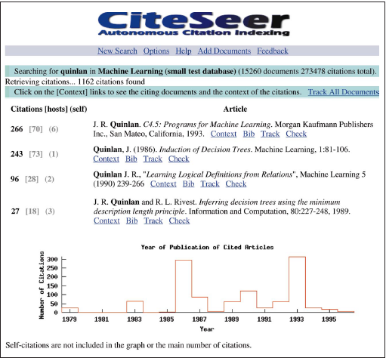
CiteSeer: Autonomous Citation Indexing
Courtesy: Lawrence et.al, “IEEE”,1999

Slide 18
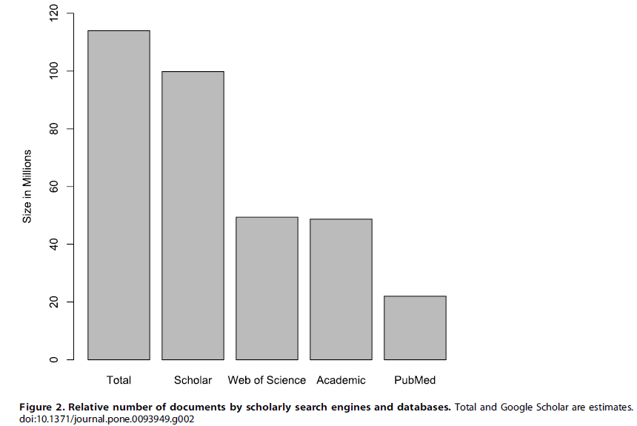
Estimated Scholarly Documents
Courtesy: Khabsa M, Giles CL (2014) The Number of Scholarly Documents on the Public Web. PLoS ONE 9(5): e93949.

Slide 19
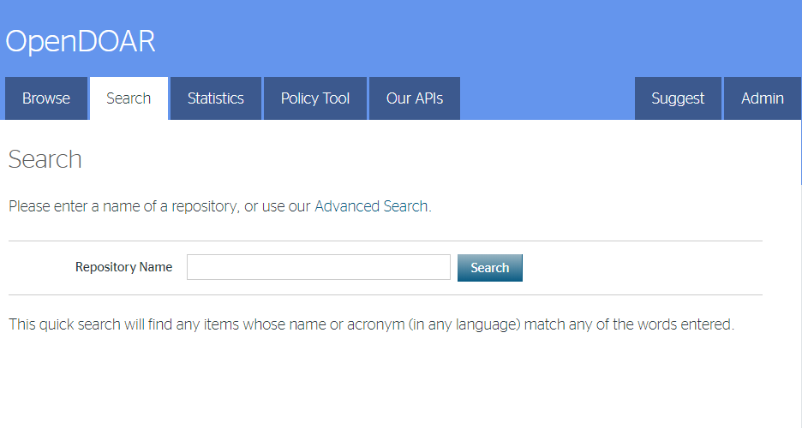
OpenDOAR: Directory of Open Access Resositories
Taken from: http://v2.sherpa.ac.uk/opendoar/

Slide 20
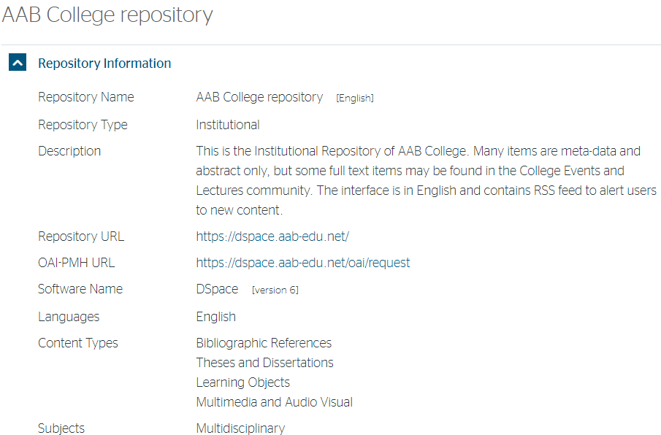
OpenDoar: Search Result

Slide 21
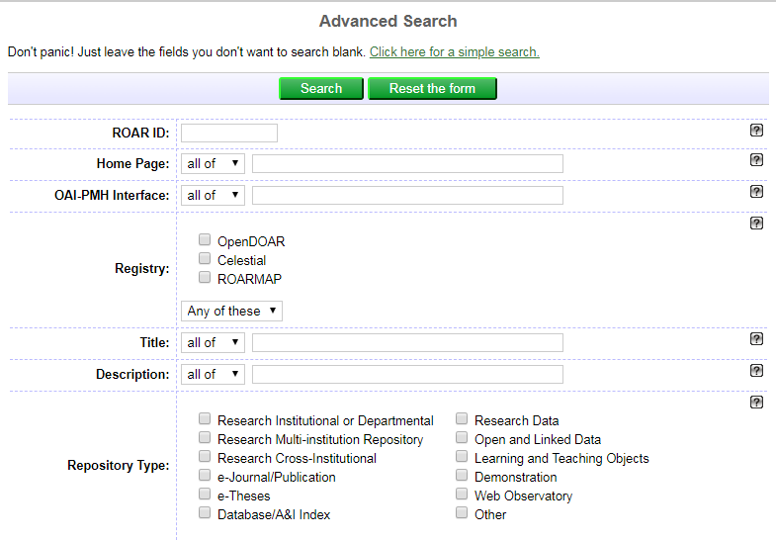
ROAR: Registry of Open Access Repositories
Taken from: http://roar.eprints.org/cgi/search/advanced

Slide 22
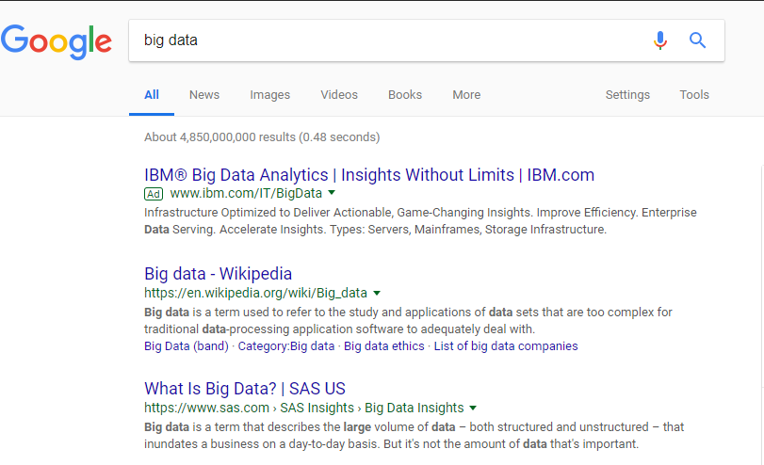
Google Search

Slide 23
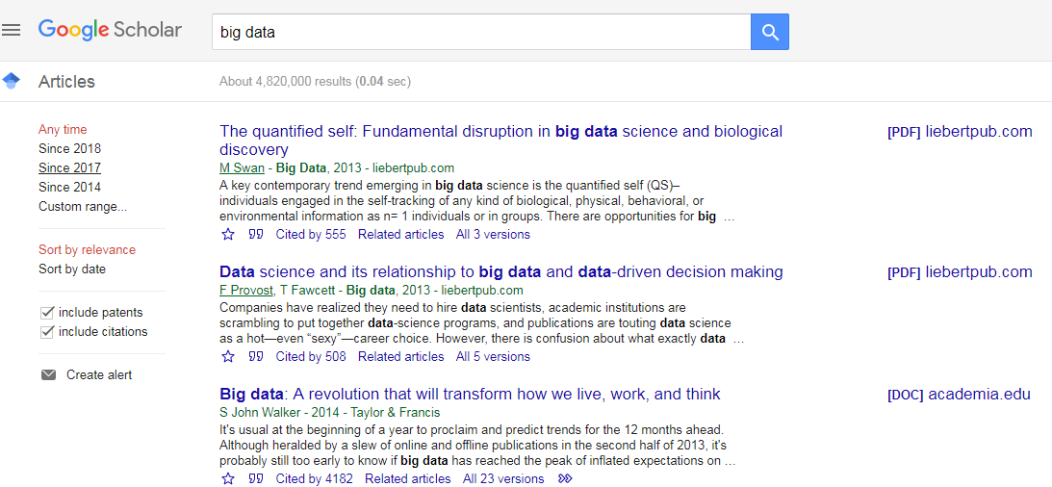
Google Scholar

Slide 24
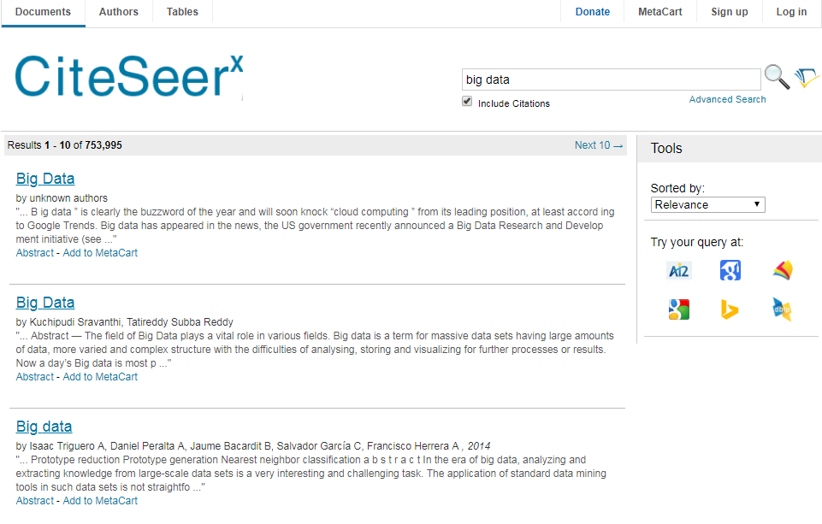
CiteSeerX

Slide 25
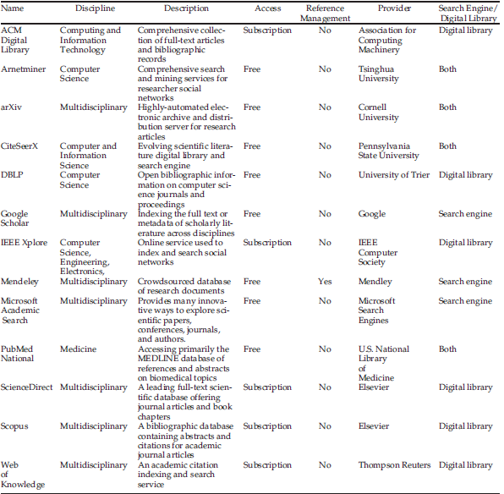
List of Major Academic Search Engines and Digital Libraries
Courtesy: Xia et.al, “Big Scholarly Data: A Survey”, IEEE Transactions on Big Data, 2017

Slide 26
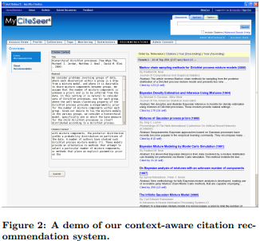
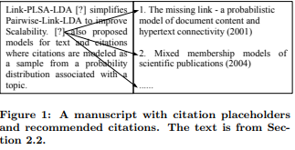
Literature Recommendation
Courtesy: He, Q et.al., “Context-aware citation recommendation.” WWW 2010

Slide 27
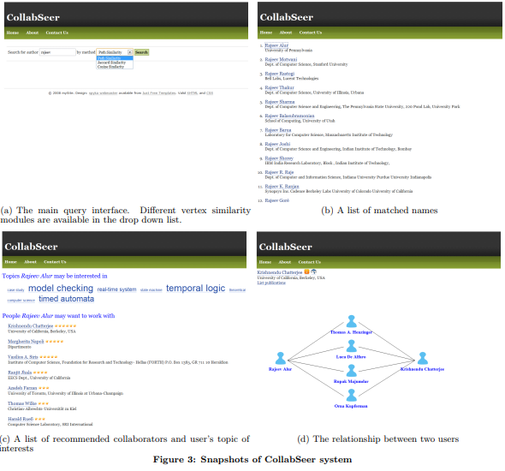
Collaboration Recommendation
Courtesy: Chen, H et.al., “CollabSeer: a search engine for collaboration discovery.”, JCDL 2011

